Slide 1

MVC Views In Depth
Joe Wilson
Volare Systems, Inc.
Email: joe@volaresystems.com
Blog: http://VolareSystems.com/Blog
Twitter: joe_in_denver

Slide 2
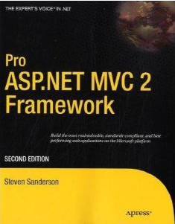
The Book
Steve Sanderson, Pro ASP.NET MVC 2 Framework, Second Edition

Slide 3
Agenda
What are Views?
Master Pages and Partial Views
Encoding
CODE: Generating a view from a Model
CODE: HtmlHelpers
CODE: Editor and Display Templates
CODE: Model Validation

Slide 4
What are Views?
Are .ASPX and .ASCX files
Inherit from ViewPage
Holds user interface elements (HTML, CSS, JavaScript)
Views should not contain much logic
Simple “if”s or “foreach”es are OK
Sanderson: separating presentation from application logic

Slide 5
Master Page, View, Partial Views
Master Page
View
Partial View
Partial View

Slide 6

Encoding
These are equivalent:
Use the shorter “:” syntax if in .NET 4

Slide 7
Code!

Slide 8
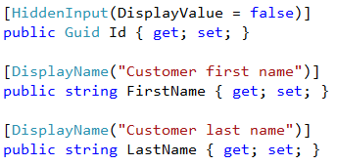
Templates – Customize

Slide 9
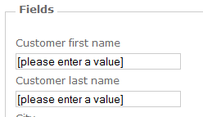
Templates – Customize

Slide 10
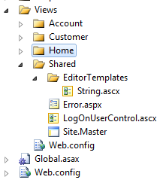
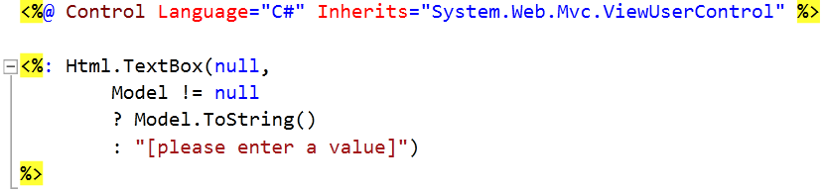
Templates – Customize

